Slide 1
Feature Engineering

Slide 2
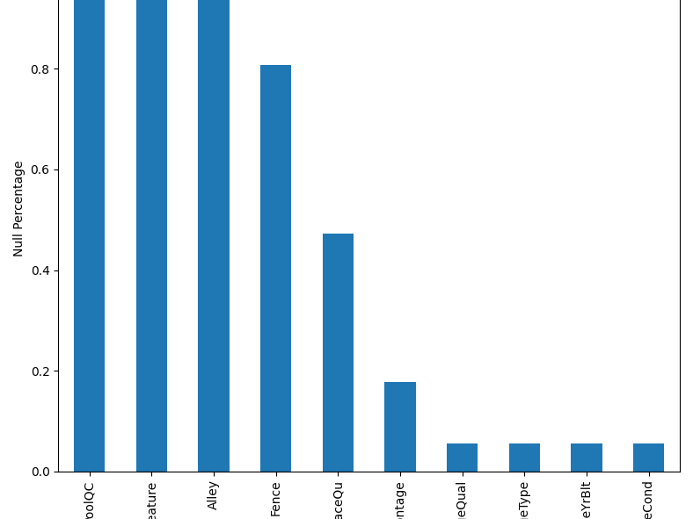
Features with many unknowns
Check if there are some easy features to drop early. Pool quality, misc feature, and alley are almost entirely nan. After a little inspection, I believe they can be dropped.

Slide 3
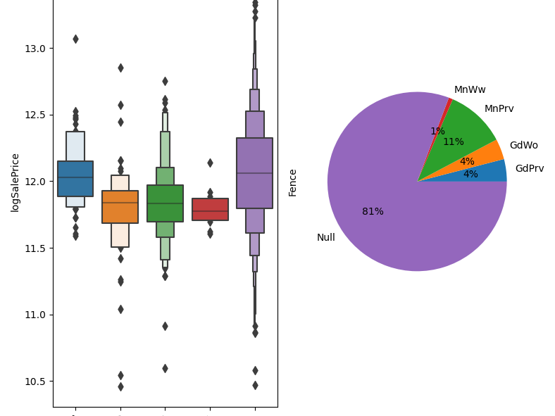
Fence
Null values means no fence. But I'm skeptical 81% of homes don't have a fence? Also, I would expect homes with a fence to have more value, but here we see all categories with a lesser saleprice. I don't see an effective way to feature this and decide to drop fence.

Slide 4
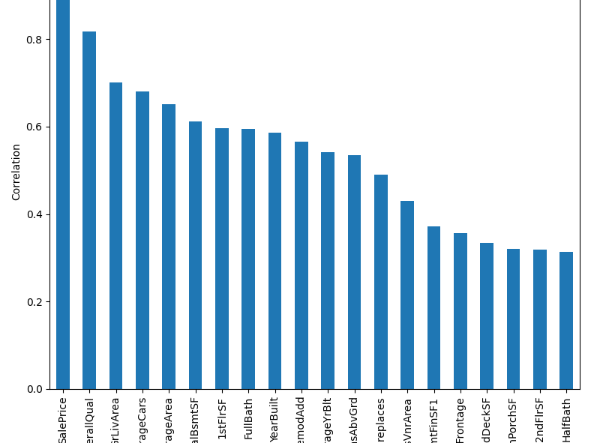
Largest Correlations
The features with largest correlation are not surprising. Overall quality, living area, size of garage, etc. Let's work our way down through these categories, being aware of features that are related. (Number of garage car spaces vs garage area should be very similar).

Slide 5
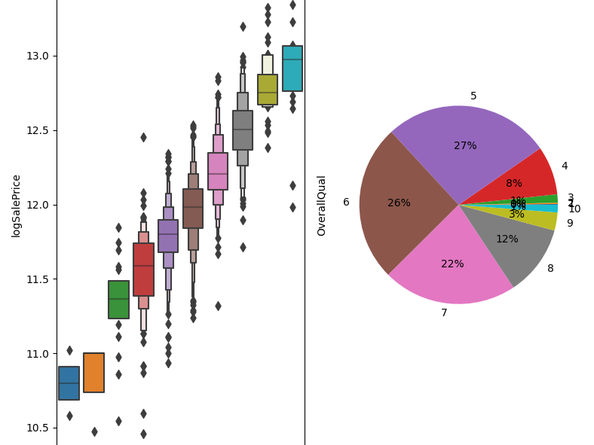
OveralQual
Very strong relationship. Definitely include.

Slide 6
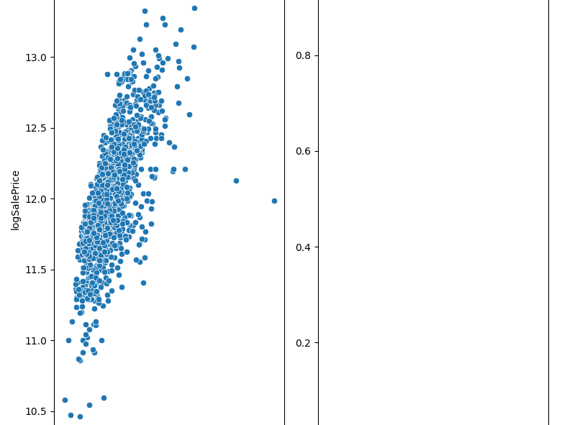
GrLivArea
I don't like the long right tail in the GrLivArea distribution. They take away from the clear linear trend. Let's apply a log transform.

Slide 7
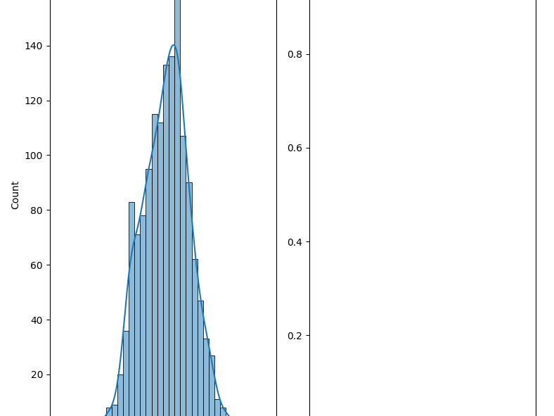
logGrLivArea
Much more symmetric and closer to gaussian. There is also a large correlation between the sale price and the log transform.

Slide 8
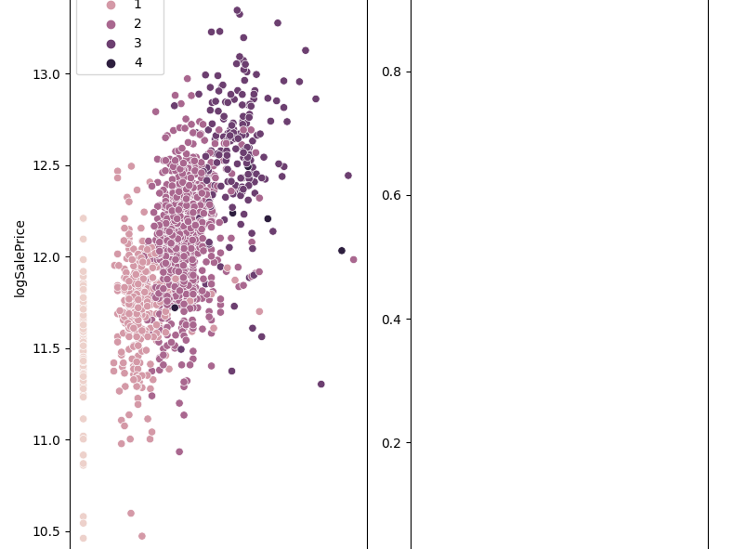
Garage Properties
There is a clear relationship between number of cars and garage area. The correlation is higher for number of cars and I don't see what garage area would add.

Slide 9
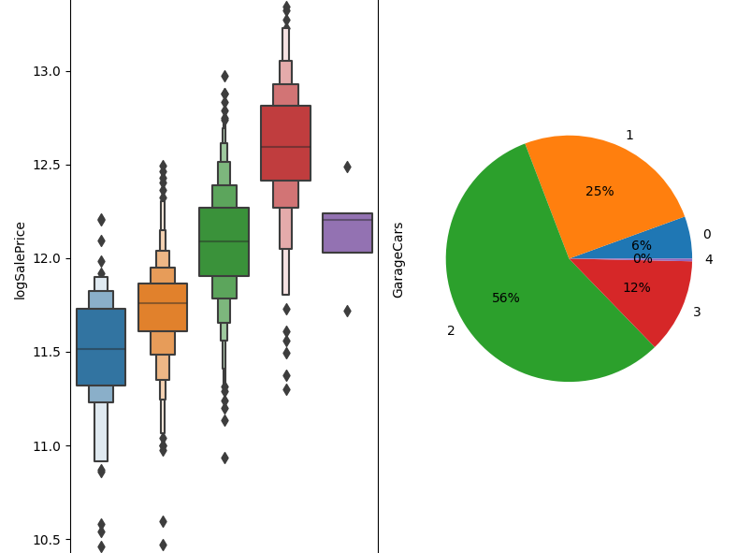
Looking at garage cars specifically, the dependence appears to be quadratic for 0-3 cars. There is negligible 4car garages, so it is hard to argue the quadratic is wrong with so little data. Would be worth creating a sqrGarageCars feature?

Slide 10
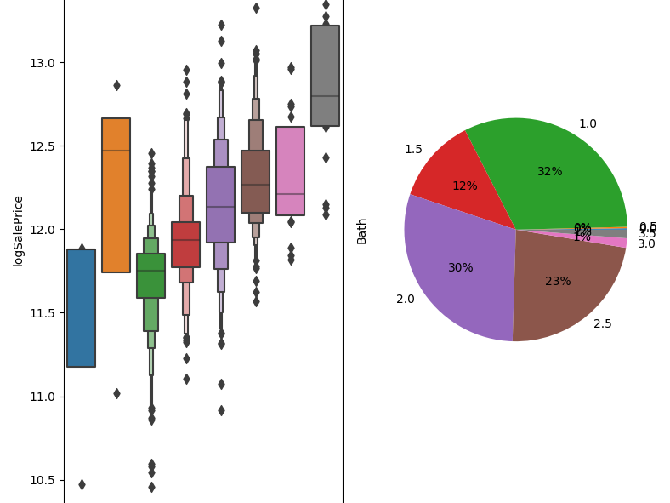
Baths
I choose to create a new feature for the total number of baths. It has a higher correlation with saleprice than fullbath and halfbath. We see 1-2.5 baths make up >95% of the data and have a very linear relationship with price.

Slide 11
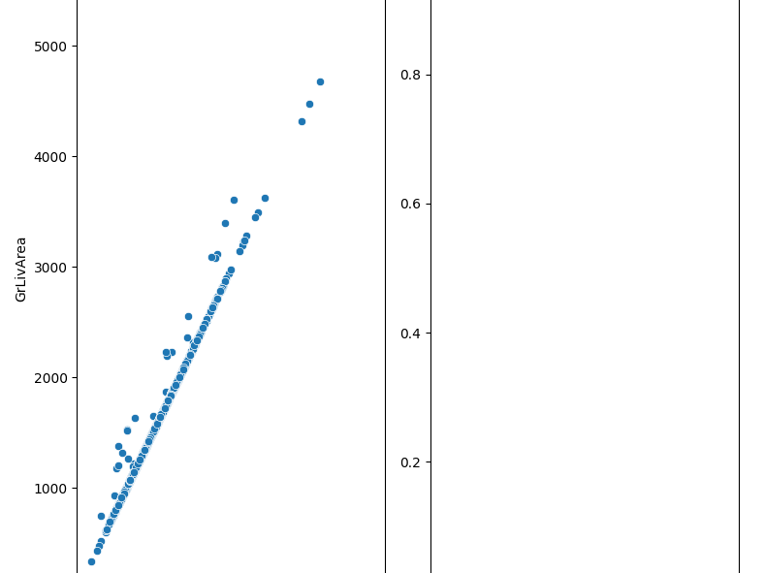
Other Square Footages
GrLivArea is the livable square footage and very similar to FlrSF (sum of first and second floor square footages). We see that some homes must have livable square footage in the basement. I don't see the reason to include 1stFlrSF or 2ndFlrSF as number of floors is encoded in other features. A feature should include specifically basement livable?

Slide 12
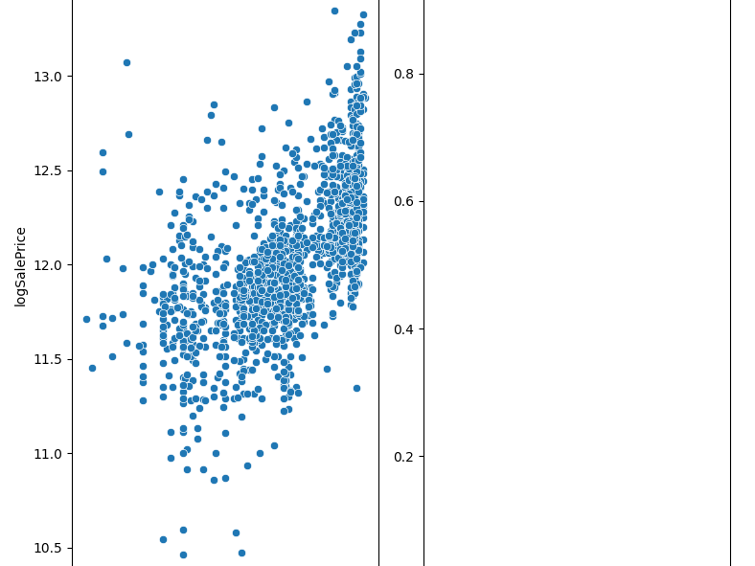
Year Built and Remodeling
The relationship between house age and sale price seems nonlinear, flatter for homes built before 1950 and more sloped for homes built since 1950. Even though YearRemodAdd has less correlation, it puts a minimum on age at 1950, which makes the data overall more linear.

Slide 13
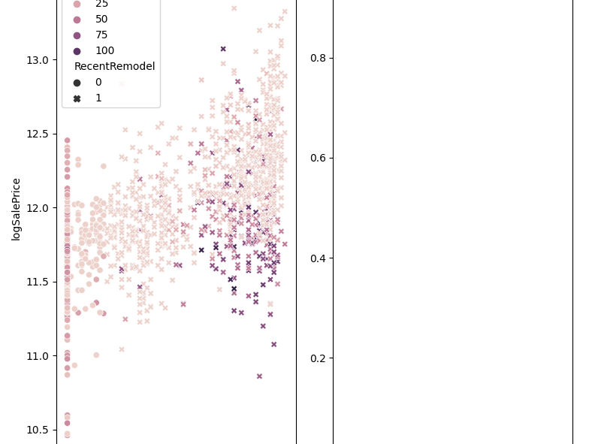
I add a feature to track recent remodels and the age of the house when remodeled. It's clear that for new house the age when remodeled makes a clear difference. I combine these features into a single RecentRemodelAge.

Slide 14
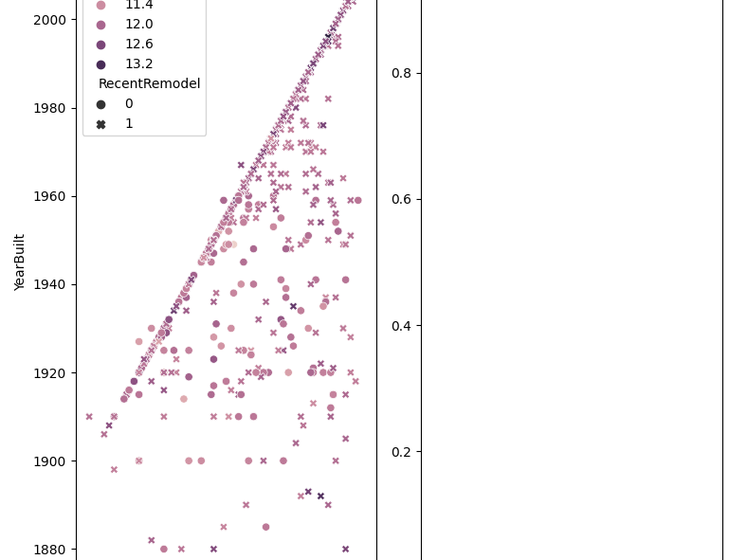
GarageYrBlt
Garages may have been build more recent without being considered a full remodel. However, I don't see much of a relationship between these newer garages and sale price.

Slide 15
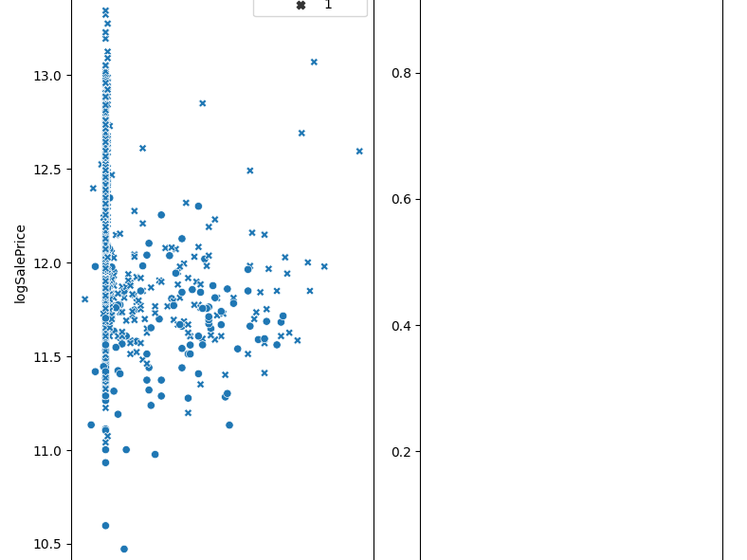
This plot makes that more clear by plotting the age of the house when the garage was most recently built.

Slide 16
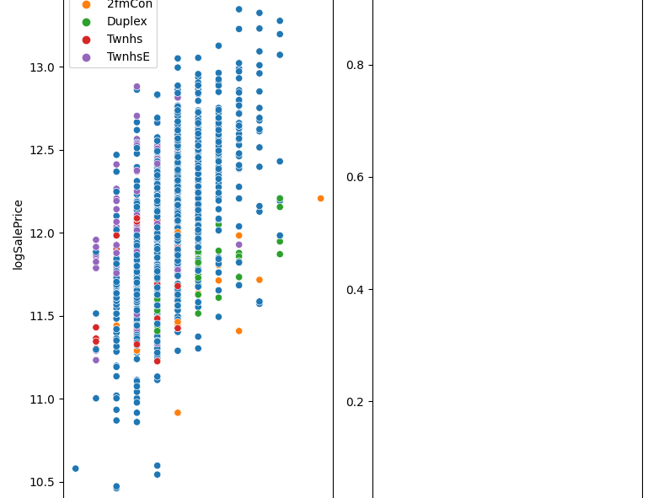
Total rooms and bedrooms
There is clearly a weak correlation between total rooms and number of bedrooms. I tried creating new features that could have higher correlation (ratio of bedroom to total rooms), but didn't have any luck. Maybe there are undlying variables like BldgType... This would be handled automatically by creating polynomial interaction features.

Slide 17
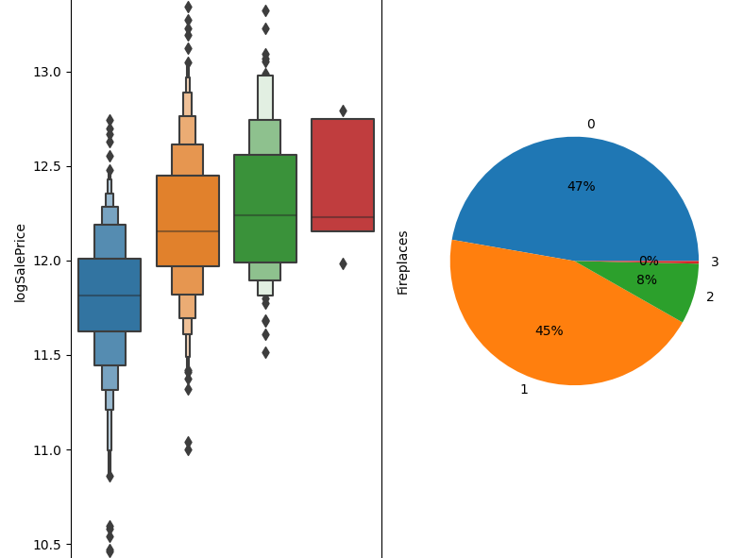
Fireplaces
The number of fireplaces does affect price, but really on the general existence of fireplaces. There is little difference between 1 or 2 or 3 fireplaces. So create a hasFireplace feature.

Slide 18
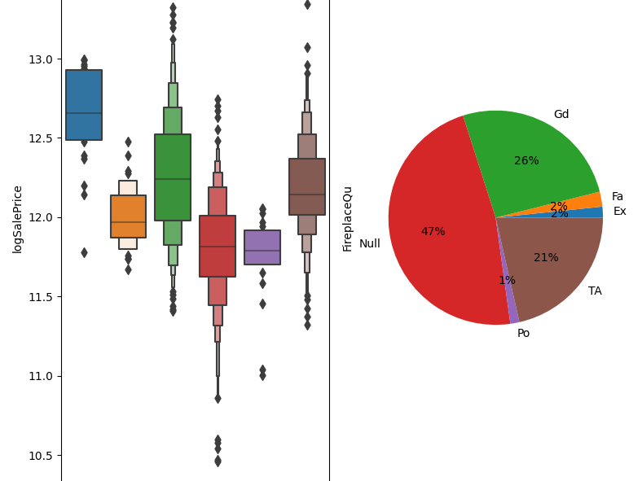
Fireplace Quality
There is a large correlation between fireplace quality and logSalePrice (not seen in correlation plot because it is a category). But if you rearrange the columns, you can see that an encoding of Po-Fa-TA-Gd-Ex has increasing saleprice. Null is similar to have a poor fireplace.

Slide 19
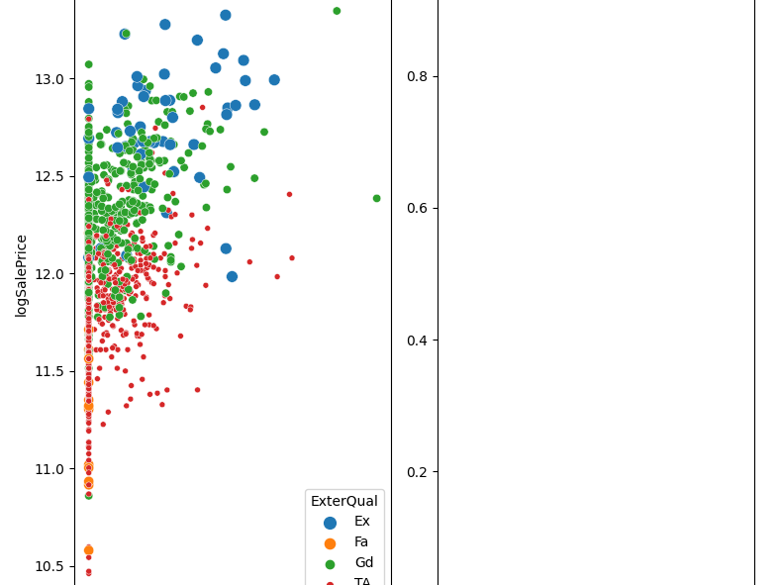
MasVnrArea
MasVnrArea has a correlation with sale price, but when you plot by ExterQual and look at each color, it's hard to say there is a significant correlation anymore. The correlation is really between logSalePrice and ExterQual. I don't think I should use MasVnrArea as a feature.

Slide 20
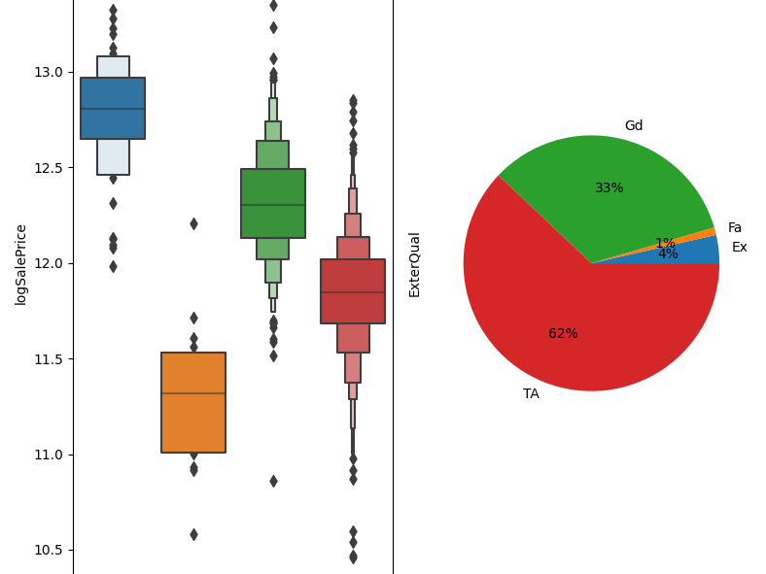
Here we see the strong correlation with ExterQual. Note order of quality is Fa-TA-Gd-Ex.

Slide 21
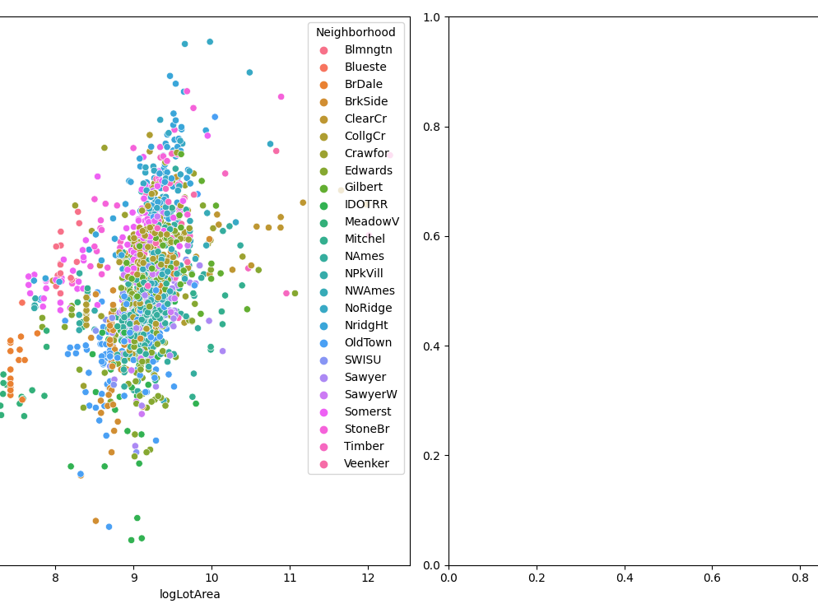
LotArea
I am surprised LotArea has such a low correlation with sale price. I think this is because we haven't accounted in any way for the neighborhood of the lot. It might be worth using a log transform on the area as well. Check how strong the correlation is if you divide saleprice by median of neighborhood?

Slide 22
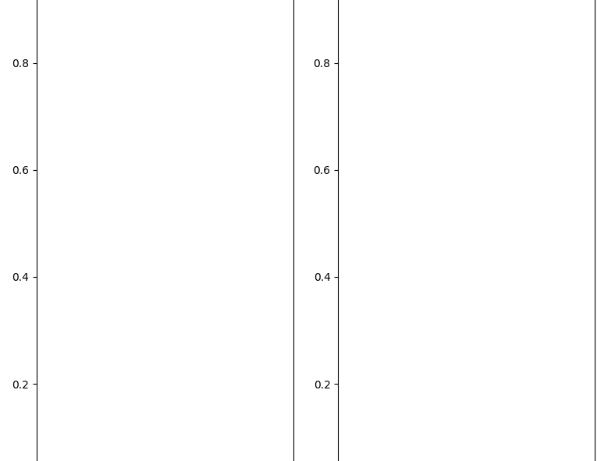
Analyzing Categorical Variables
Now we work through the categorical variables to see which could be useful.

Slide 23
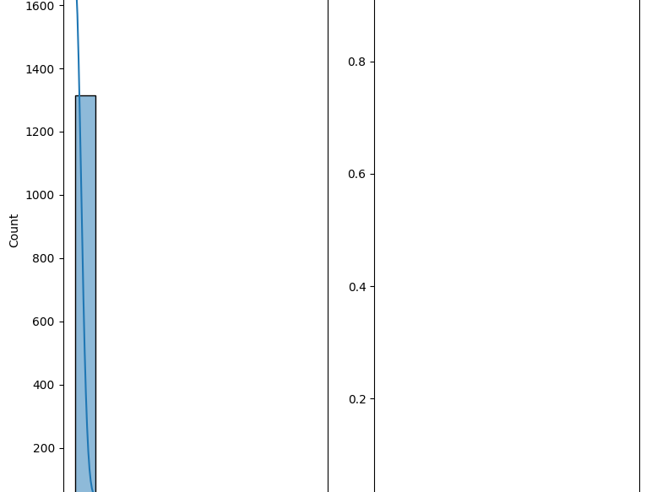

Slide 24
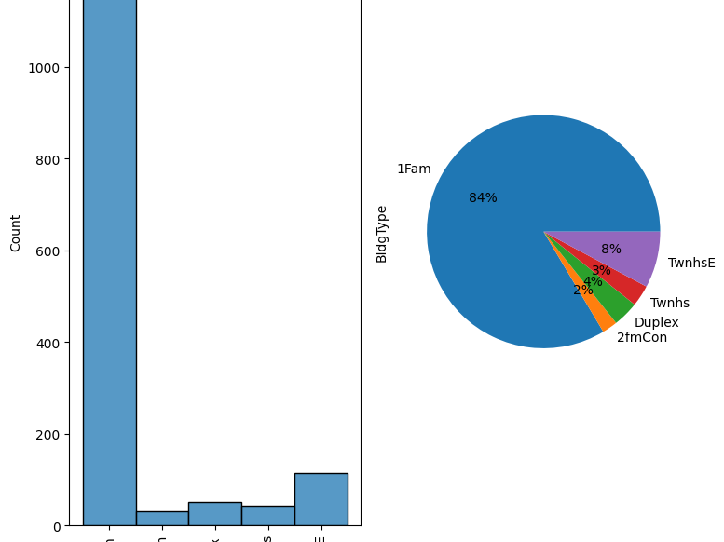

Slide 25


Slide 26
